Slide 1
COVID19 UPDATES
Android project

Slide 2
Project description
This Covid-19 tracing tool helps you view the global stats of the pandemic efficiently.

Slide 3
Problem definition
Since the outbreak of COVID19, we came up with a plan to make an application to get the latest stats on corona(state-wise) which is currently handy.

Slide 4
Social benefits
User friendly.
Not sophisticated.
No prior knowledge is needed to use this application.
Works fine in lower bandwidth.
User gets the latest stats about the pandemic.
Get stats from worldwide.

Slide 5
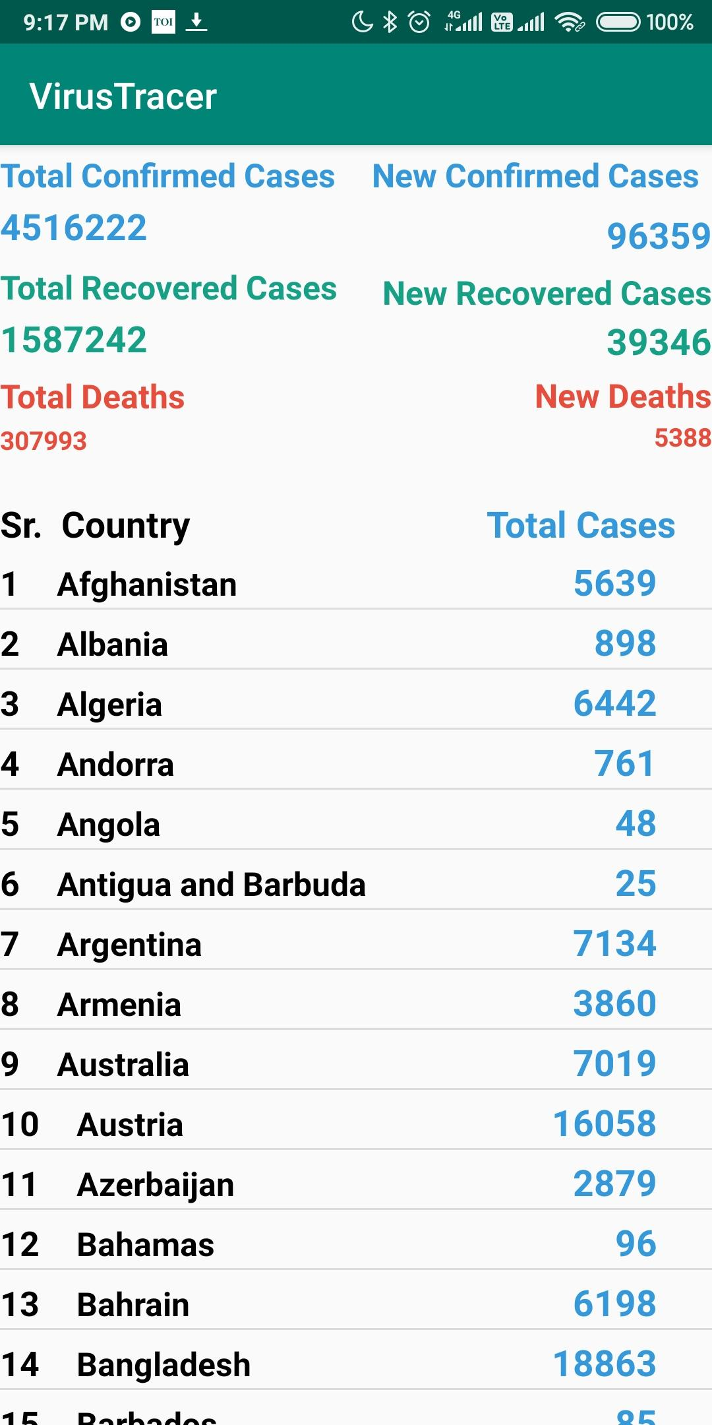
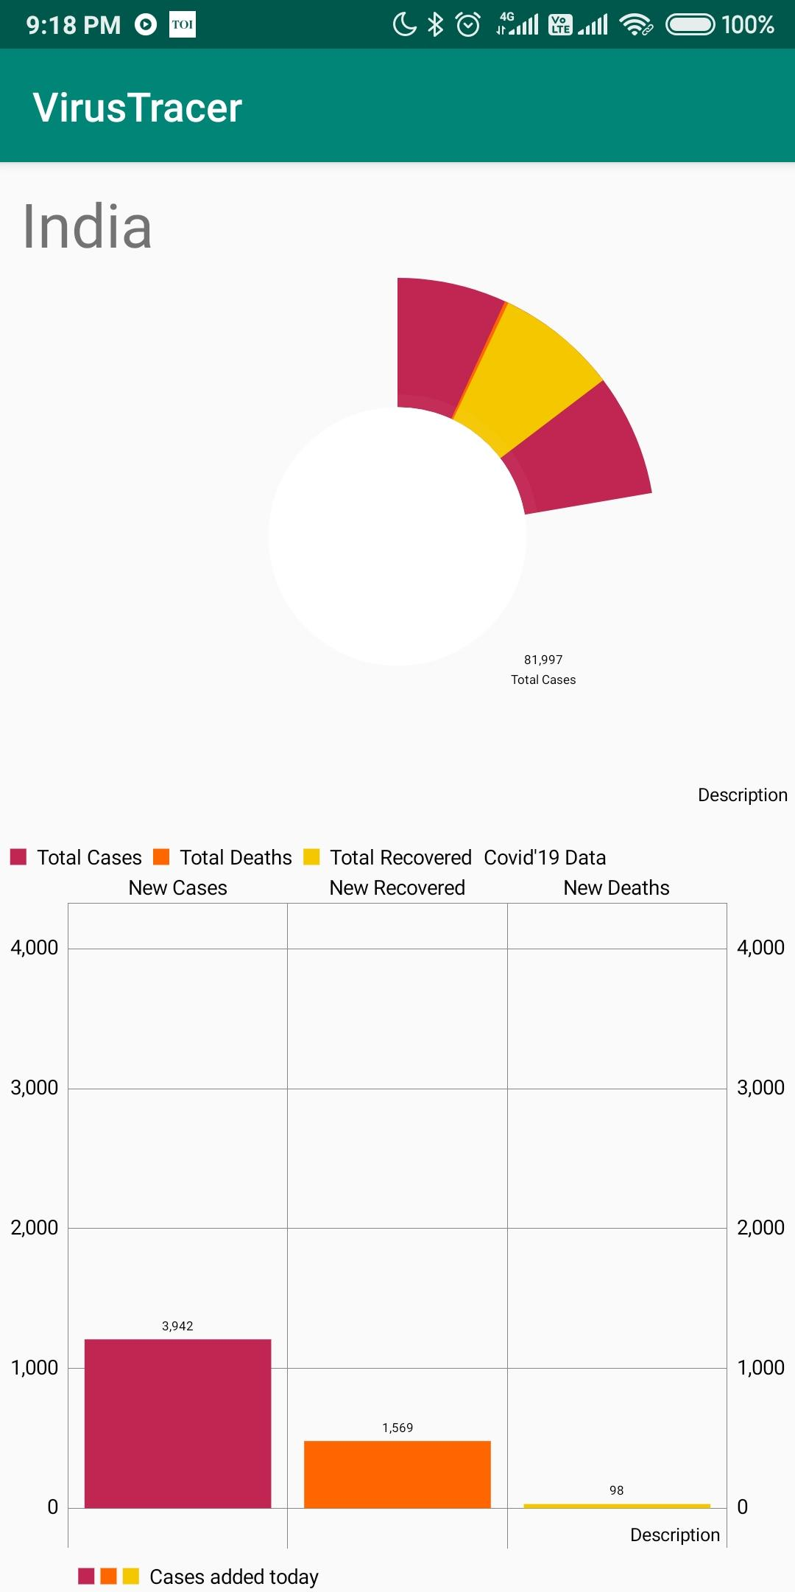
Screenshots

Slide 6
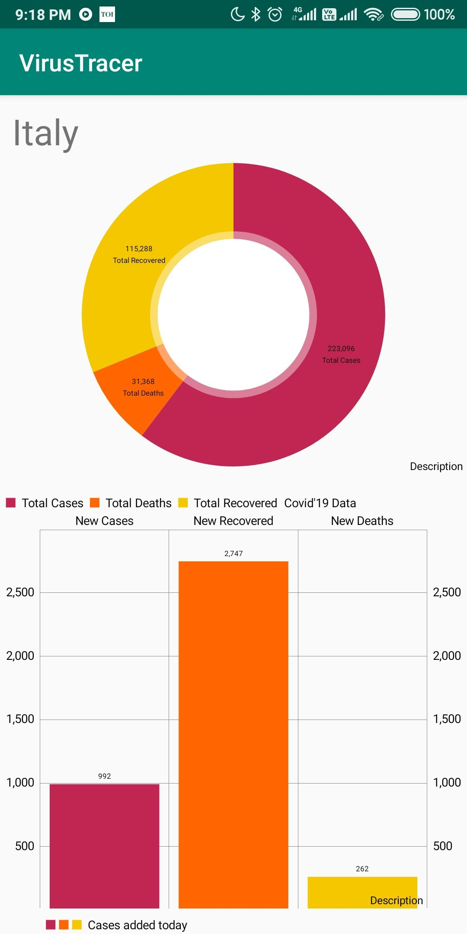
Screenshots

Slide 7
Requirements
Android Phone/Tablet
Android 5.1(Lollipop), and above
Internet connection

Slide 8
Components used
Hashmaps and arraylist
ListView, Textview, Pie Chart, Barchart, Relative Layout and Linear layout.
Asynctask
Http-handler and service call
All function of json object and json array
Pre execute method
Do in background method
Post execute method.
Intent

Slide 9
Bugs
App kept crashing when there was delay in getting json data.
App showed only the country names without data.
Graphs weren’t showing the latest data.

Slide 10
Difficulties we faced
It was difficult to get the json payload.
Making graph against real time data

